Slide 1


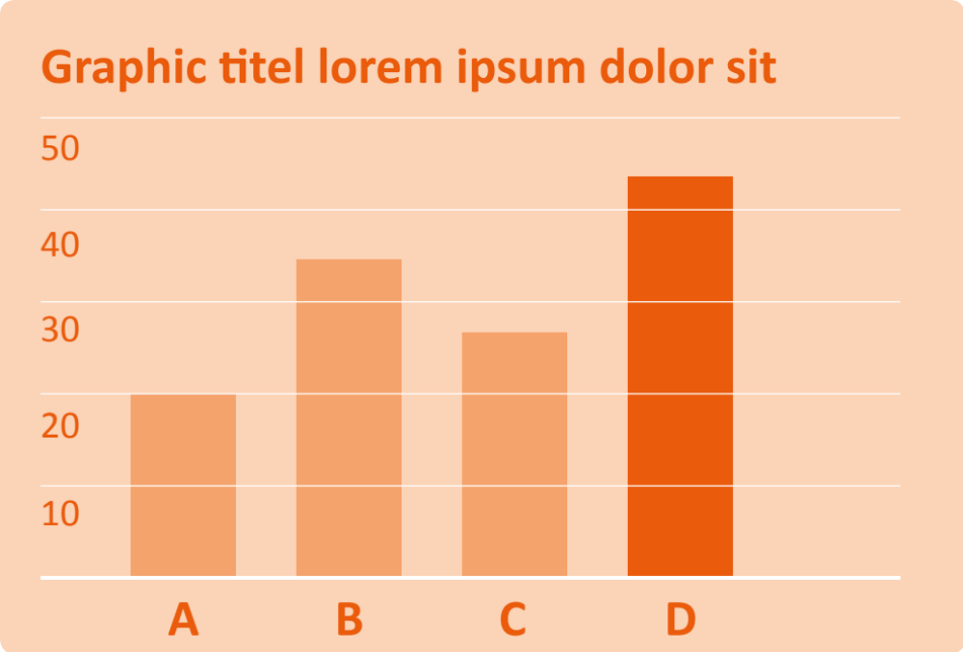
Max Ex. Sample | School | City | Country Aptos Display Bold 40 pt
Project Title Aptos Display Bold 95 pt
Subtitle if necessary Aptos Display Bold 60 pt
This is the project description. The text is set in 40 points. This might seem large but you have to consider, that the distance between the reader and the poster might be quite big, so a large typeface is essential for readability. Also you should not overestimate the average reading time of a poster. A clear structure also helps the reader to quickly understand, what your poster is about so highlighting facts with a bold typeface and colour might be useful.
This is only an example on how to structure your poster design. Stick to your guiding theme’s colour scheme and use a clear division of space.
Conclusion: At the end of the poster you might place a conclusive sentence which can run over three to four lines and is set in the typeface Aptos, 60 points.

